Slide 1
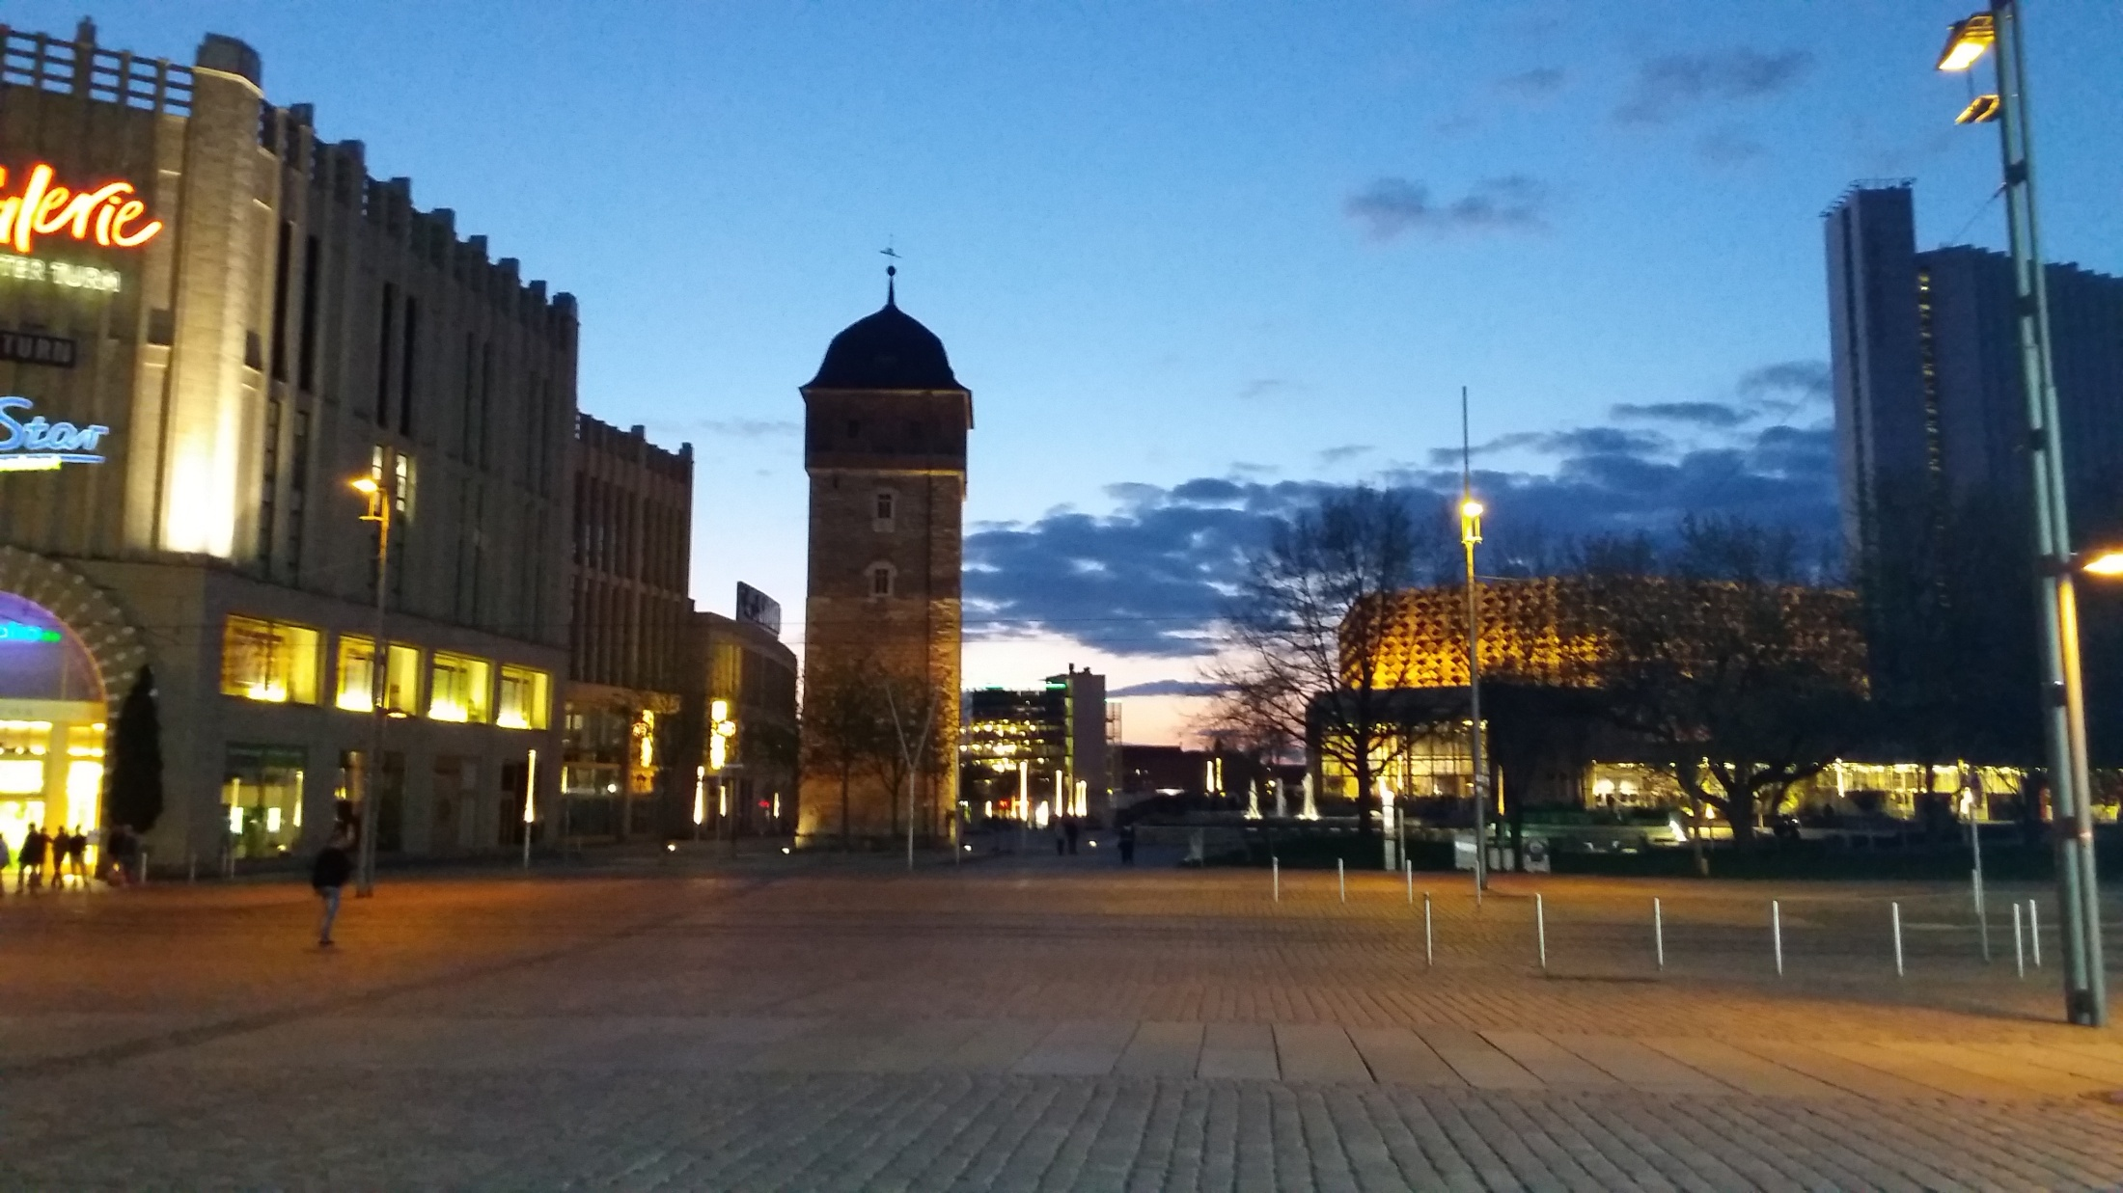
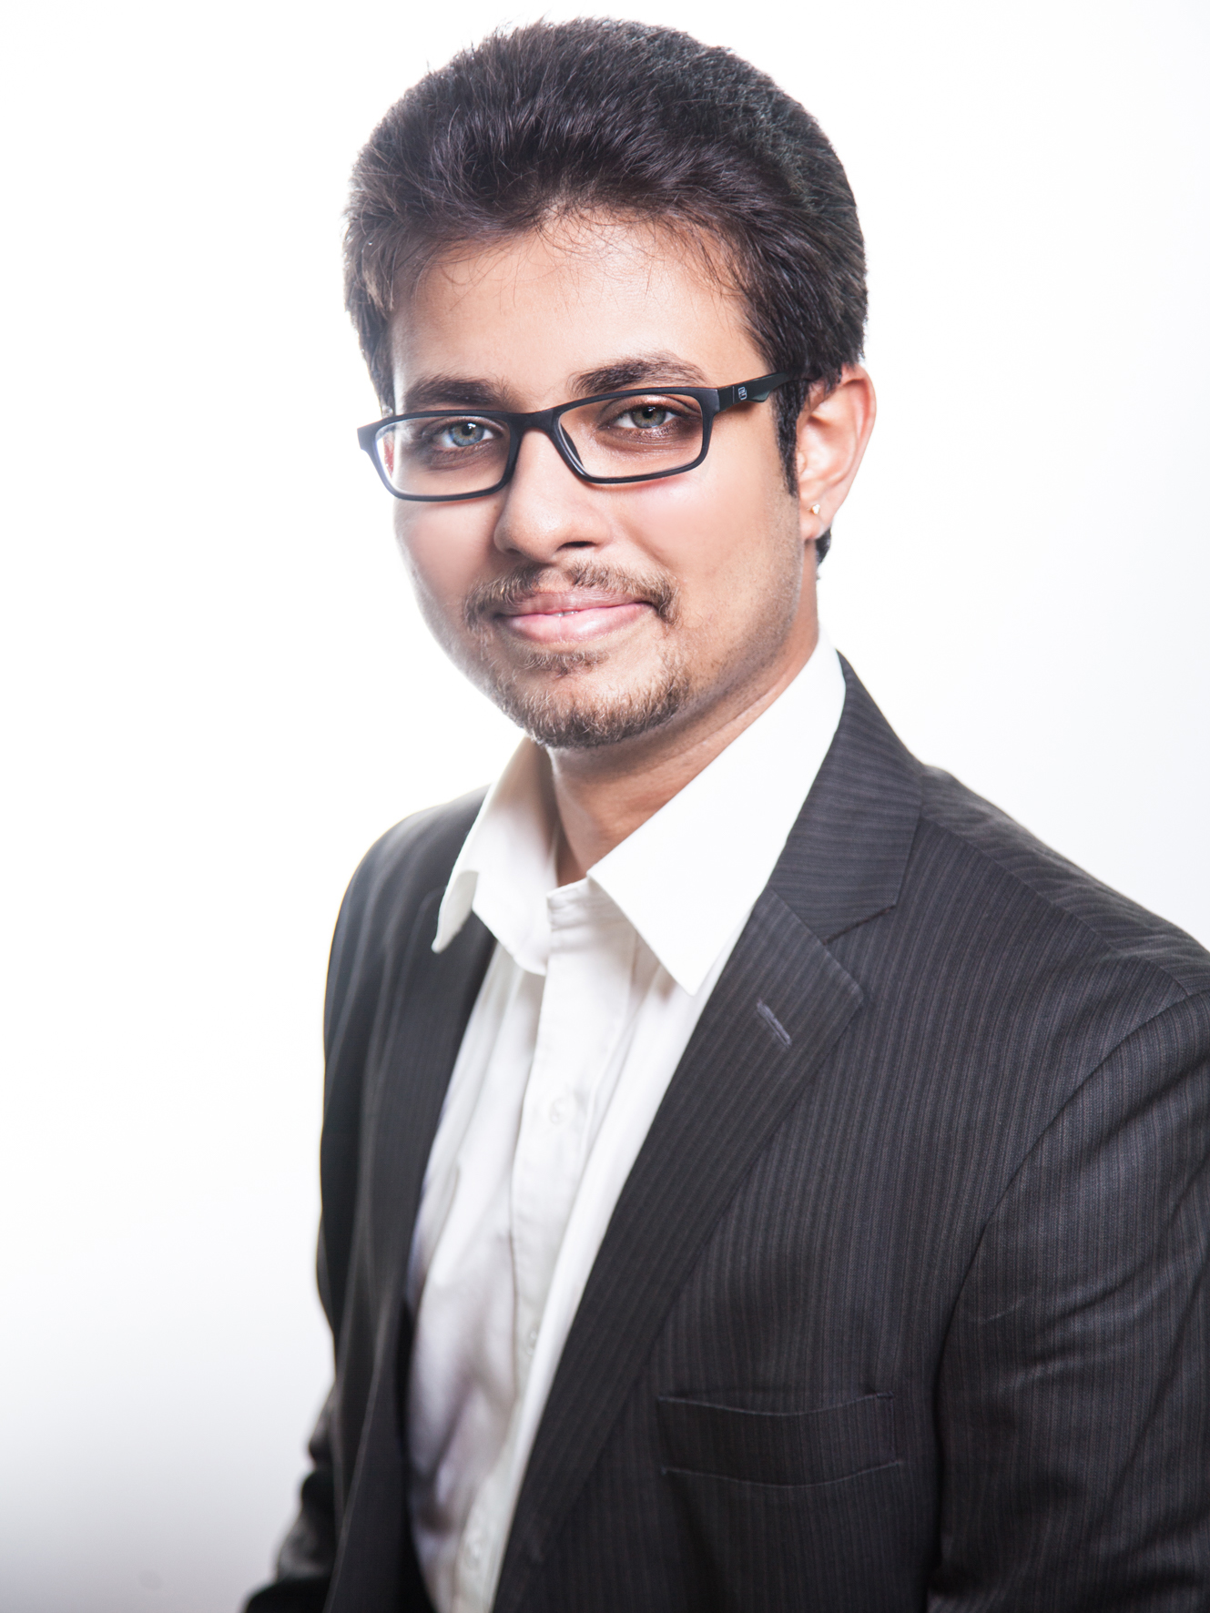
Pavan Krishna Deshpande
M.Sc. in Information and Communication Systems
B.E. in Electronics and Communication Engineering

Slide 2
Bachelor Thesis
2014
“Biometric Identification and Authentication of Hand Vein Patterns”
Internship
2017
“Identification and Analysis of Solder Grains in a Sample”
Master Thesis
“Setup and Evaluation of Trinocular Omnidirectional Stereo Vision Systems for Indoor Surveillance”
2018-2019

Slide 3
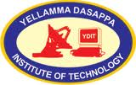

Bachelor Thesis
Designing a novel biometric system based on human hand veins
1
Research
Question
Stand-alone system
Good performance in spite of artifacts
4
2
Existing methods - inefficient
Unique vein patterns
Difficult to falsify
Observations
Motivation
Tools used
3
3
Presented in the 7th IEEE Student Conference
NIR circuit and CMOS camera
Matlab and image processing techniques

Slide 4
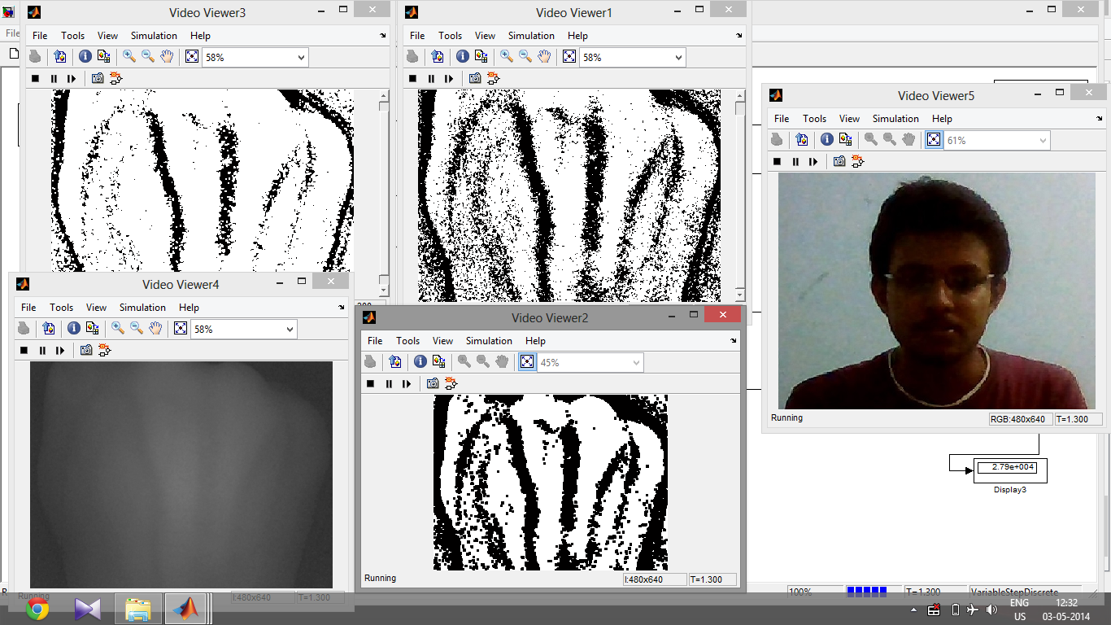
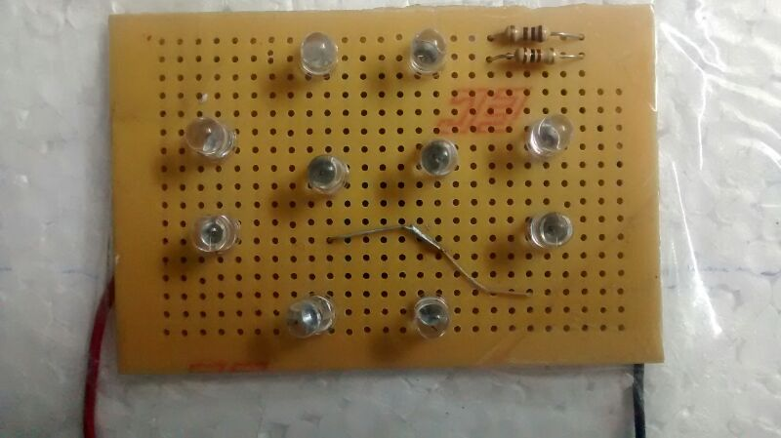
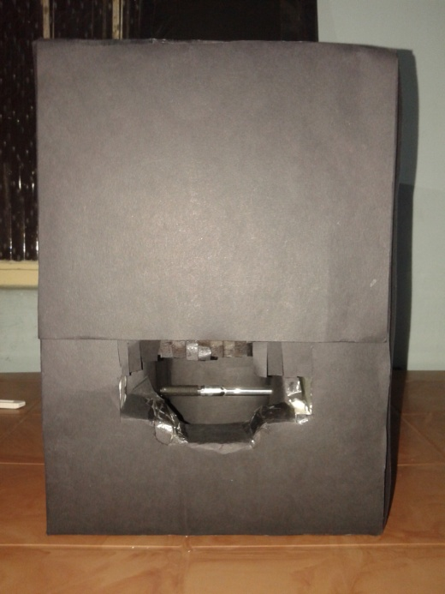
Bachelor Thesis - Results
1
2
3
Figures 1, 2 and 3 represent final outputs, NIR circuit and working prototype
respectively

Slide 5

Internship
Effectively analyze the solder grains in a sample
1
1
Research
Question
Research
Question
Automated algorithm reduced the manual time
Efficient method to identity and mark solder grains
4
2
Grain size – important property
Change in physical properties
Observations
Motivation
4
Observations
Motivation
2
Tools used
Tools used
3
Matlab's Image Processing Toolbox™
Watershed and image processing algorithms
Workflow in an Agile Environment
3

Slide 6
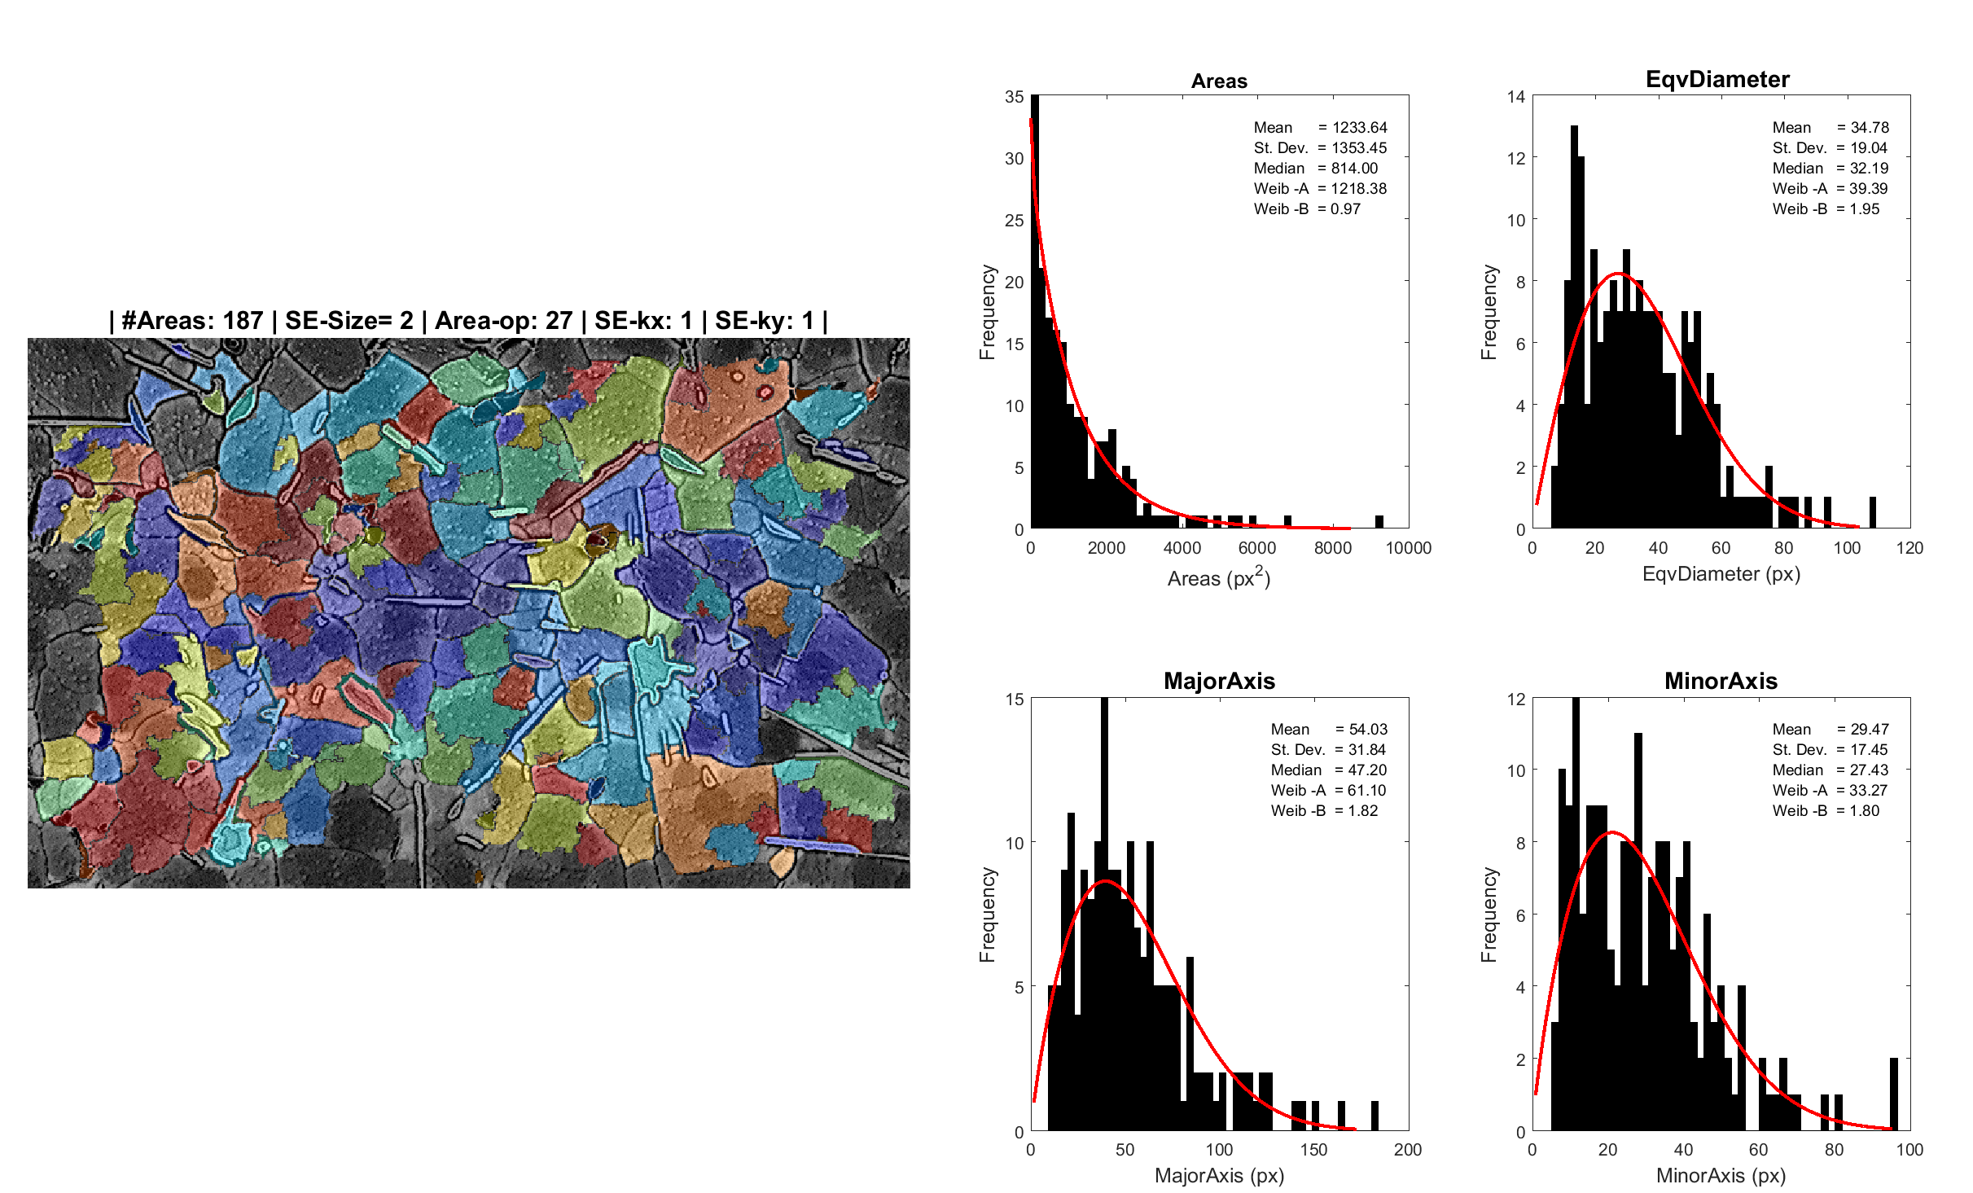
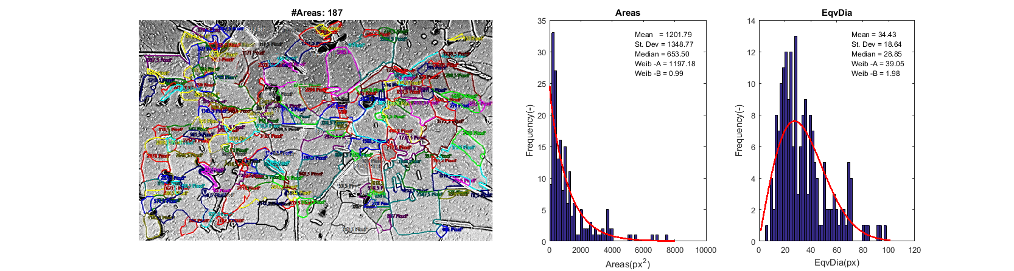
Internship - Results
Figure 4: Validation of results

Slide 7
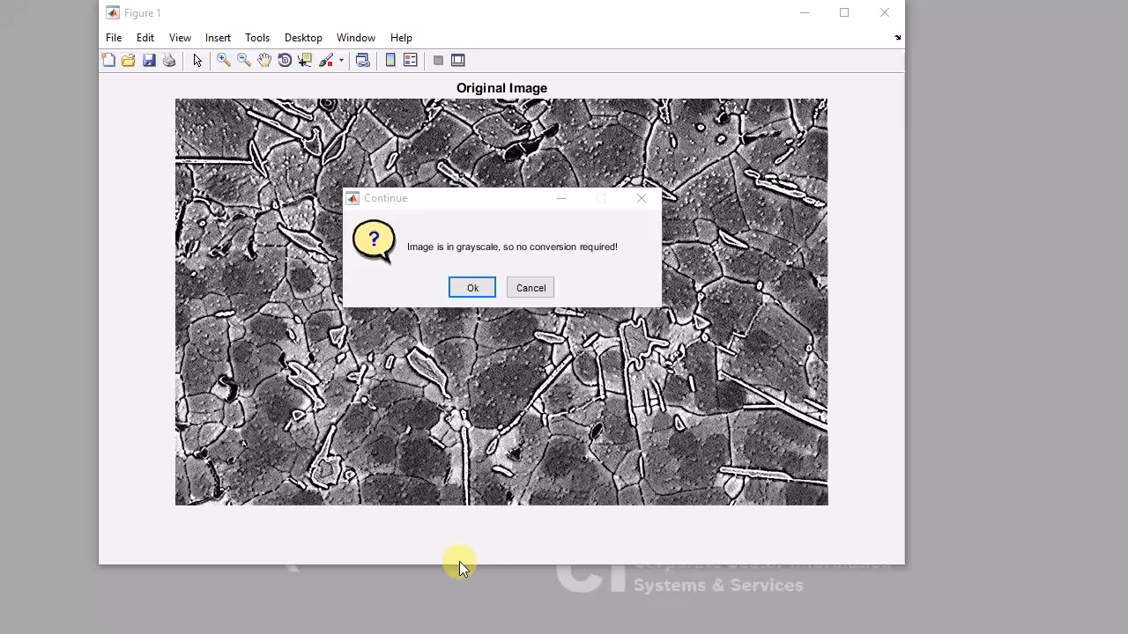
Internship - Results

Slide 8

Master Thesis
To setup and evaluate a trinocular omnidirectional stereo vision system along with point cloud reconstruction
1
1
Research
Question
Research
Question
A complete hemispherical point cloud is generated
Competitive evaluation of point clouds is achieved
4
2
Assisted Ambient Living
More than 2 sensors for optimal scene reconstruction
Observations
Motivation
4
Observations
Motivation
2
Tools used
Tools used
3
3D rendering – Blender (CG)
Python scripting and XPCV
Concepts of Computer Vision and 3D IP
CI/CD with GitHub
3

Slide 9
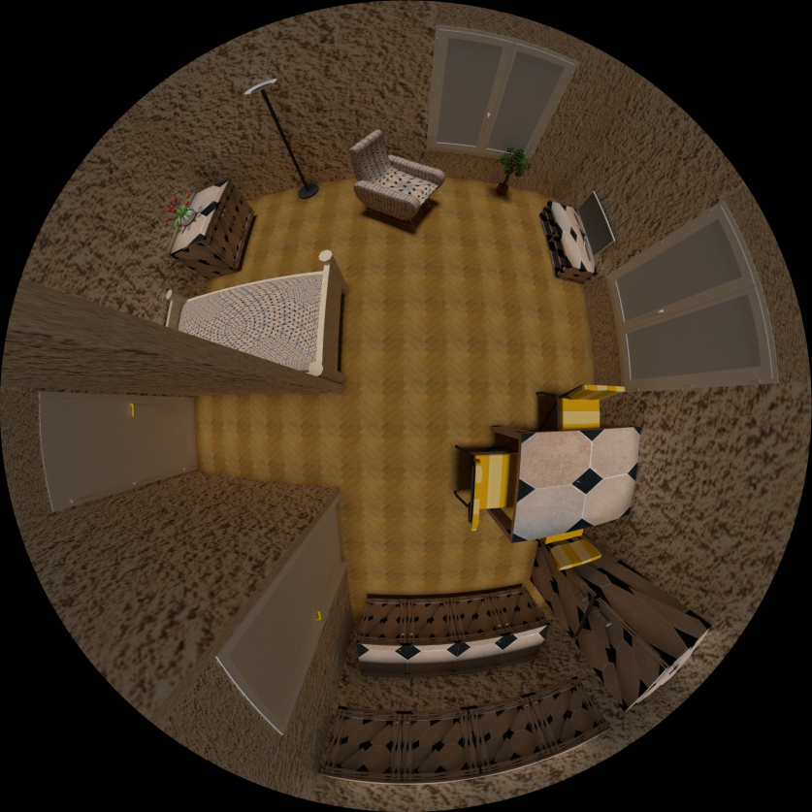
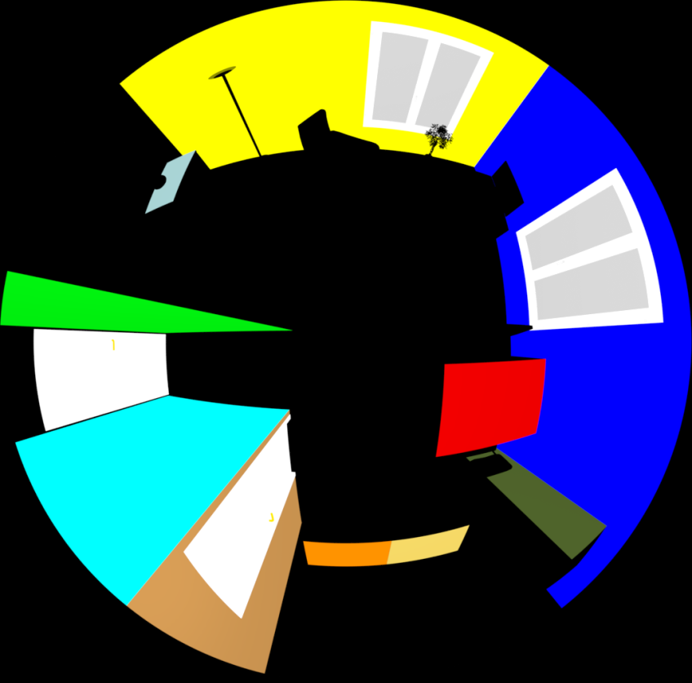
Master Thesis - Results
Figure 5: Textured and coloured images of the virtual flat, rendered automatically by the algorithm

Slide 10
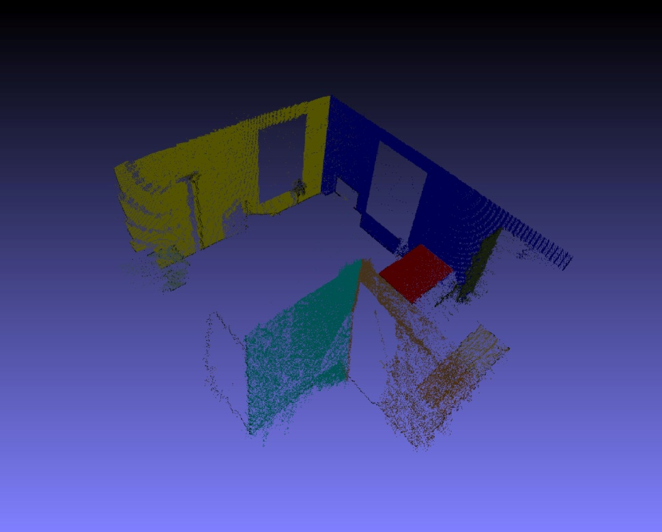
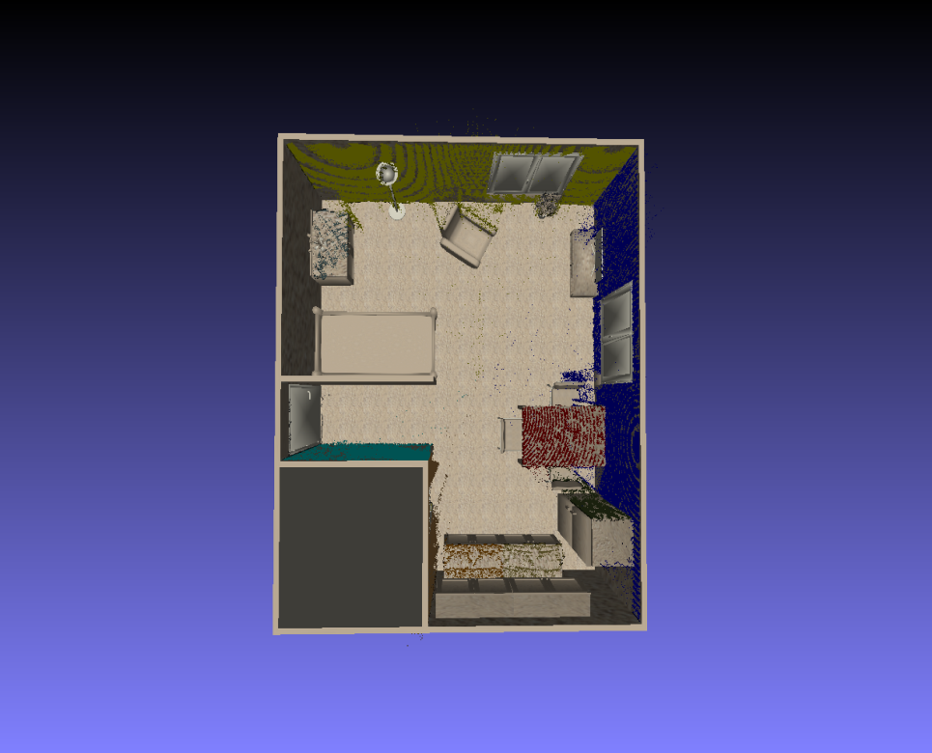
Master Thesis - Results
Figure 6: Coloured point cloud mask and superimposed on ground truth data

Slide 11
Thank you!

